Slide 1
Stock Prices & Sales Correlation using Sentiment Analysis
Analyzing online reviews for stock prices and sales correlation for automobile companies
By
Baris Baturay
Grant Preuninger
Sejal Panchal
Yuzhen Wu

Slide 2
BUSINESS GOAL ANALYSIS
BUSINESS OBJECTIVE
Can we predict stock market prices using public sentiments for Ford and Toyota?
How efficient is the sales and sentiments correlation model for Ford and Toyota?
MODEL OBJECTIVE
Ascertain correlation between sales, stock prices and sentiments using descriptive analytics.
Reliable data source - social media or online websites.
Perform predictive analytics, using data mining techniques and tools,
Predict high correlation variables using linear regression, and decision tree regressor depending on the models performance.

Slide 3
SYSTEM DESIGN FRAMEWORK
Pre-Process data for Sentiment Analysis
Crawling reviews for employees and consumers
Pre-process data for ML regression models
Perform Sentiment Analysis
Business Problem
Using regression model
Collect financial data
Evaluating model performance and results
Conduct descriptive analytics using Tableau & Python

Slide 4
DATASET DESCRIPTION
Online consumer and employee reviews for Ford Motor Company and Toyota Motor Corp.
Data Source:
Consumer reviews - Everyauto.com and Influenster.com
Employee reviews - Glassdoor.com and Indeed.com
37842 consumer reviews and 9757 employee reviews for Toyota and 35227 consumer reviews and 12418 employee reviews for Ford
Financial data: stock price, and sales per month.
Stock prices from Yahoo finance API
Sales Data from carsalesbase.com

Slide 5
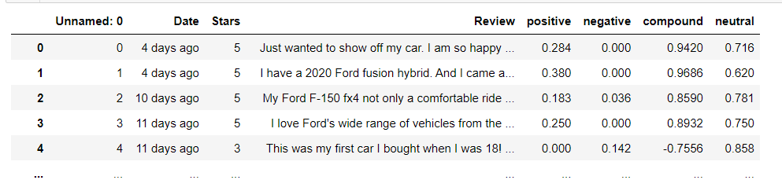
Tool and Packages
Python packages: Selenium, BeautifulSoup and HTTP Request to extract date, text and ratings from each review.
45000+ reviews are crawled for each company
Sentiment Intensity Analyzer from nltk library to perform sentiment analysis
Gave positive, negative, neutral and compound score for each review

Slide 6
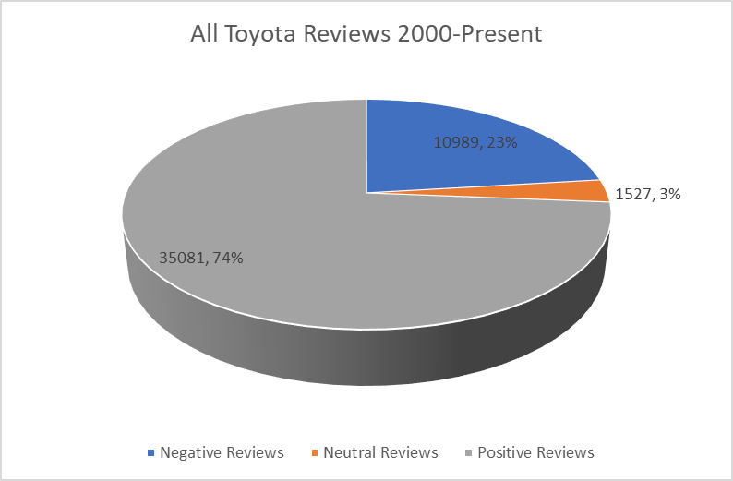
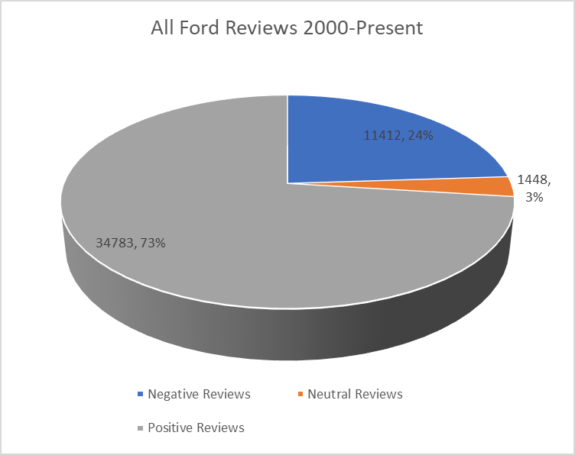
Total Reviews from 2000-Present

Slide 7
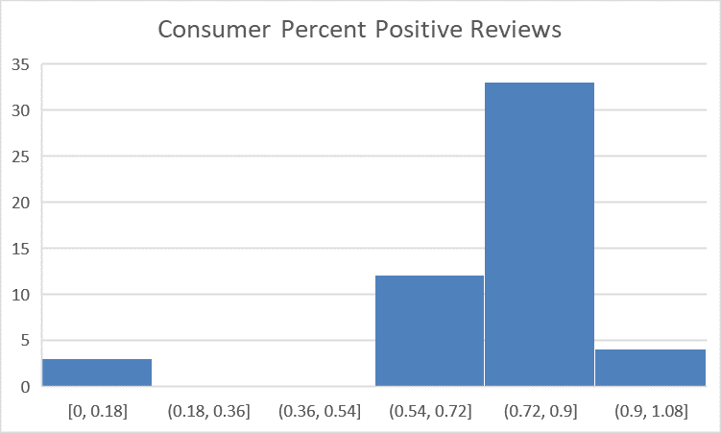
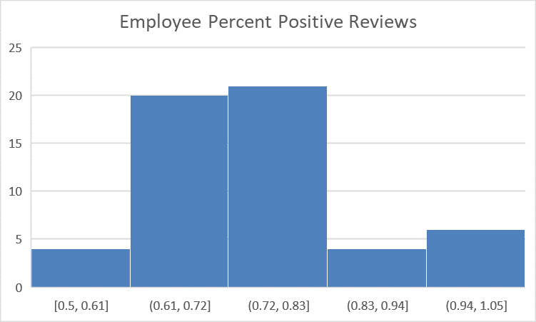
Toyota Consumer Reviews Vs. Employee Reviews
Notes:
Mention consumers have more positive reviews than employees. Menton skewness

Slide 8
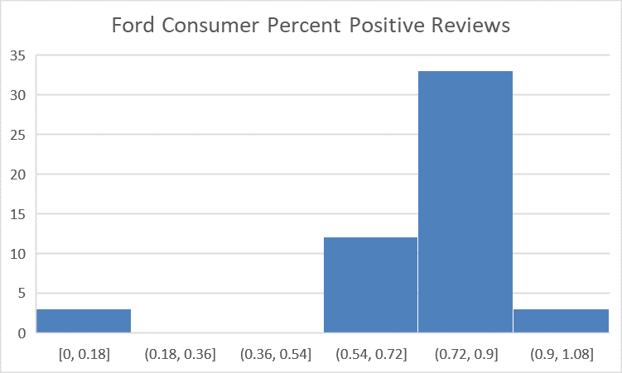
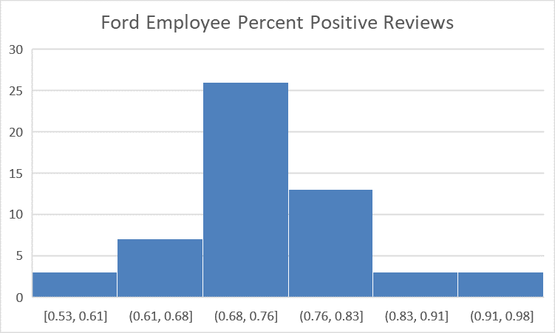
Ford Consumer Reviews Vs Employee Reviews
Notes:
X label has compound values y is percentages so scewness to right means there is more positive values in. So the employees have more bas reviews than consumers thats what we are getting out of it

Slide 9
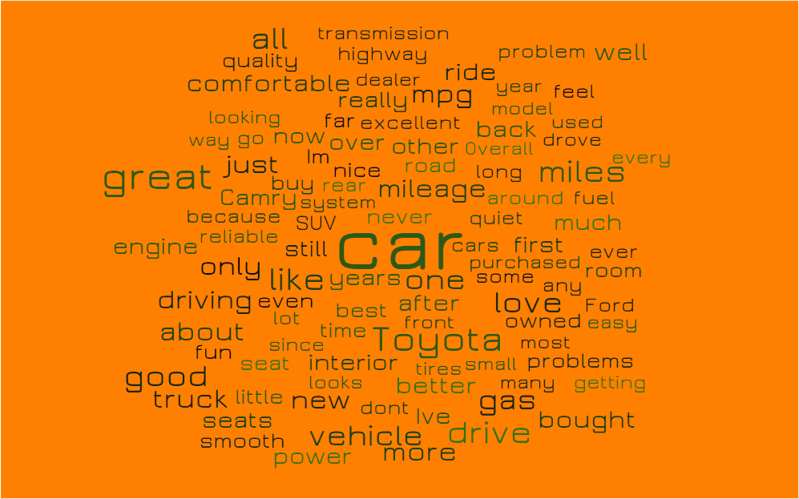
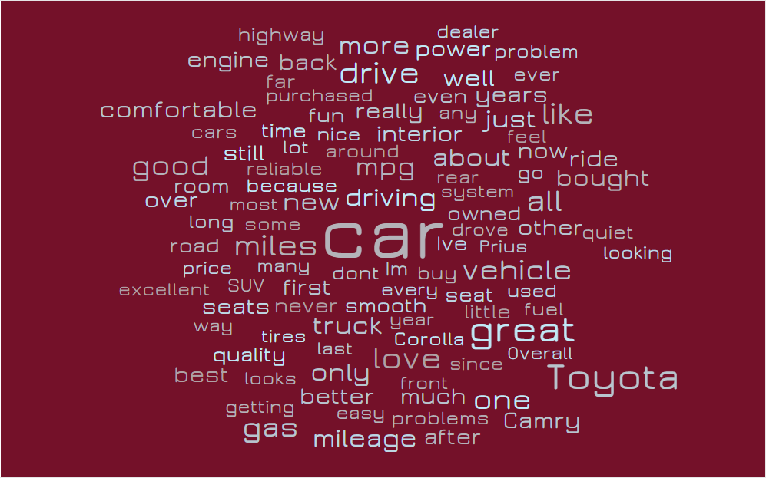
CONSUMER REVIEW
Ford Reviews
Toyota Reviews

Slide 10


EMPLOYEE REVIEW
Ford Reviews
Toyota Reviews

Slide 11
CORRELATION ANALYSIS
Toyota Closing Price Correlation
Toyota Sales Correlation
Previous Closing Price | 0.875045
Previous Sales | 0.492534
Mkt-RF | 0.142146
AvgCompound | 0.112315
AvgRate | 0.085146
PercPos | 0.082260
SMB | 0.024982
HML | 0.021634
Previous Sales | 0.544501
AvgRate | 0.031512
AvgCompund | 0.028344
PercPos | 0.027710

Slide 12
CORRELATION ANALYSIS
Ford Closing Price Correlation
Ford Sales Correlation
Previous Closing Price | 0.836425
AvgRate | 0.421957
sales | 0.201176
Mkt-RF | 0.174225
HML | 0.105982
AvgCompound | 0.105955
SMB | 0.027321
PercPos | 0.021025
Previous Sales | 0.544501
AvgRate | 0.031512
AvgCompound | 0.028344
PercPos | 0.027710

Slide 13
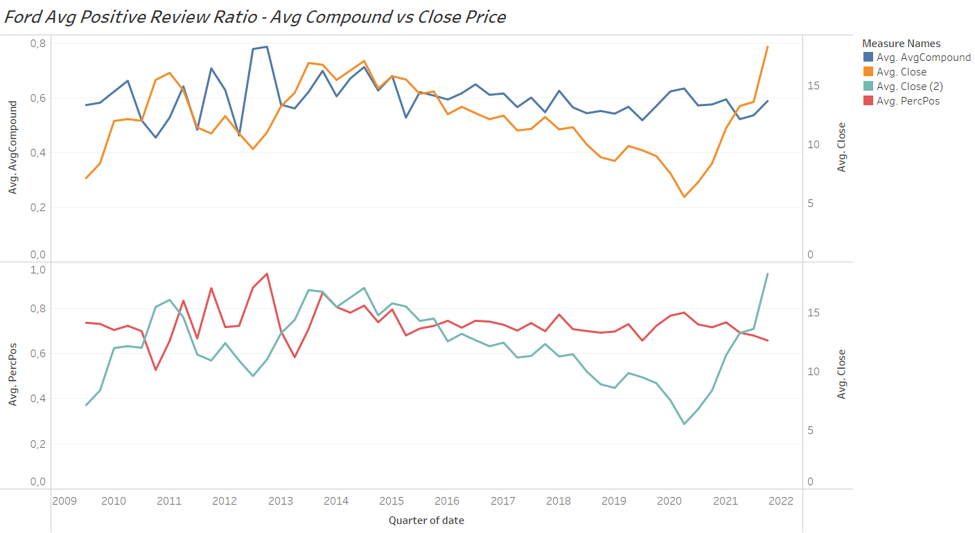
TREND ANALYSIS
Ford Average Positive Review Ratio - Average Compound vs Closing Stock Price

Slide 14
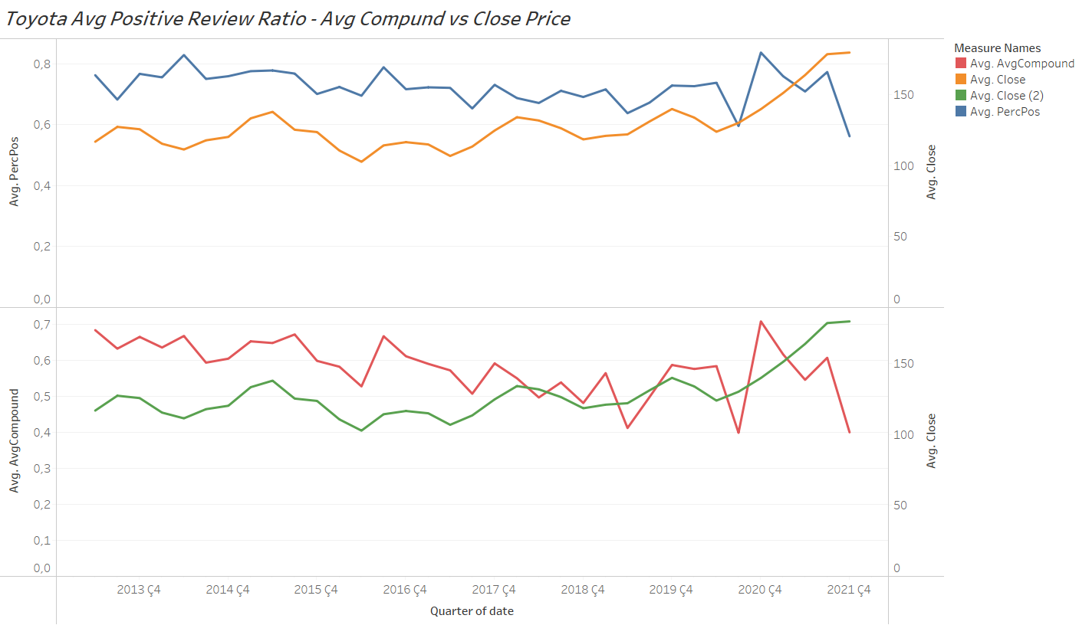
TREND ANALYSIS
Toyota Average Positive Review Ratio - Average Compound vs Closing Stock Price

Slide 15
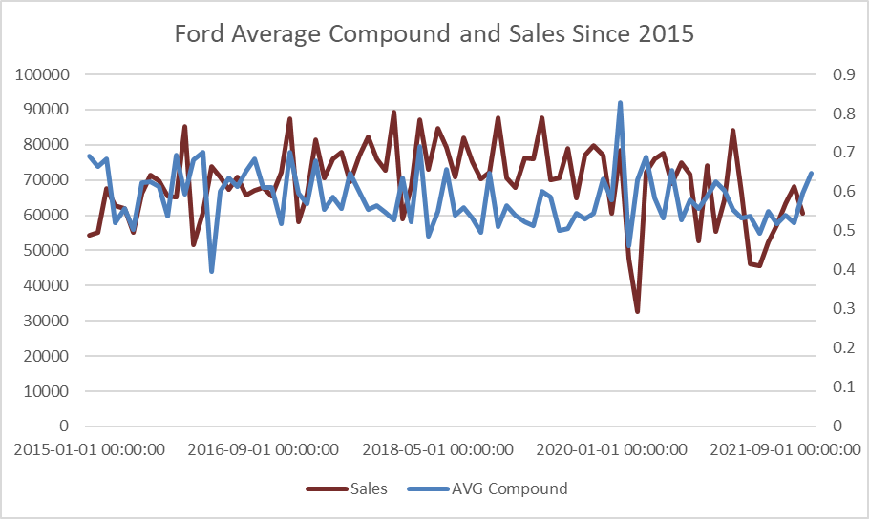
Ford Average Compound Positive Review Ratio - vs Sales

Slide 16
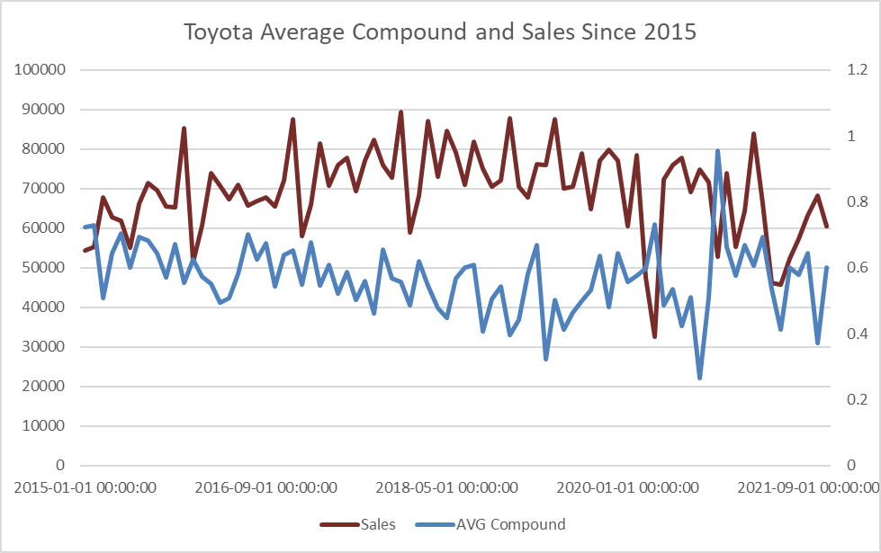
Toyota Average Compound Positive Review Ratio - vs Sales

Slide 17
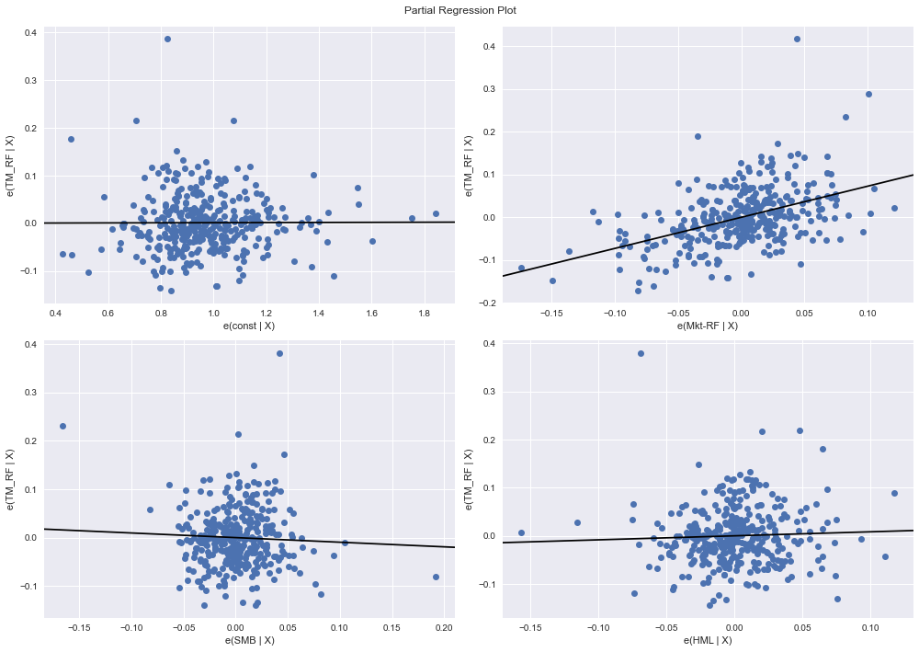
LINEAR REGRESSION - FAMA MODEL
TOYOTA
Notes:
SMB (Small Minus Big) = Historic excess returns of small-cap companies over large-cap companies
HML (High Minus Low) = Historic excess returns of value stocks (high book-to-price ratio) over growth stocks (low book-to-price ratio)
SMB: it helps to weight the model in favor of small-cap companies, as the Fama-French Three Factor model predicts that investment portfolios with smaller companies will have higher rates of return than portfolios with larger companies.
HML:It helps to weight the model in favor of value stocks, as the Fama-French Three Factor model predicts that investment portfolios with value stocks will have higher rates of return than portfolios with growth stocks.
One of the capital asset pricing models.
the relationship between the expected return and risk of investing in a security.

Slide 18
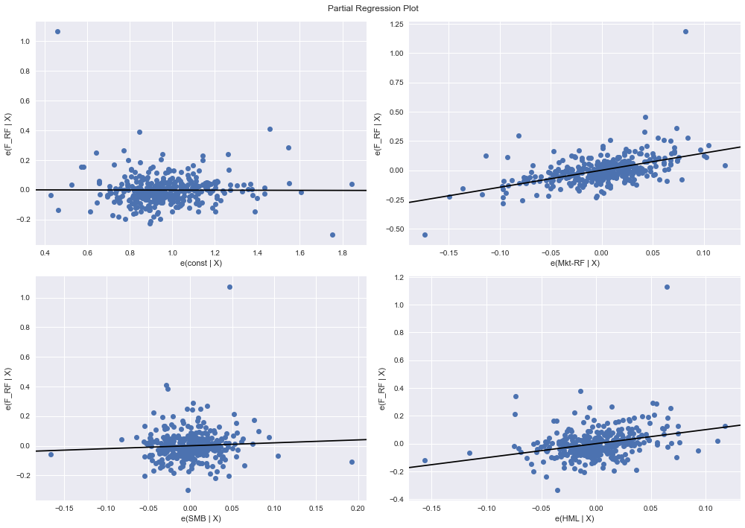
LINEAR REGRESSION - FAMA MODEL
FORD
Notes:
SMB: it helps to weight the model in favor of small-cap companies, as the Fama-French Three Factor model predicts that investment portfolios with smaller companies will have higher rates of return than portfolios with larger companies.
HML:It helps to weight the model in favor of value stocks, as the Fama-French Three Factor model predicts that investment portfolios with value stocks will have higher rates of return than portfolios with growth stocks.

Slide 19
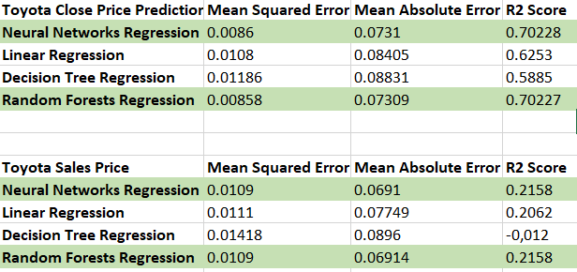
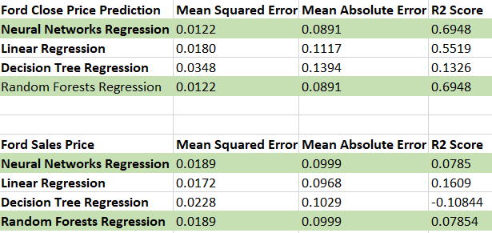
MODEL EVALUATION
STOCK PRICE & SALES PREDICTION
Toyota Stock Price & Sales Prediction Ford Stock Price & Sales Prediction

Slide 20
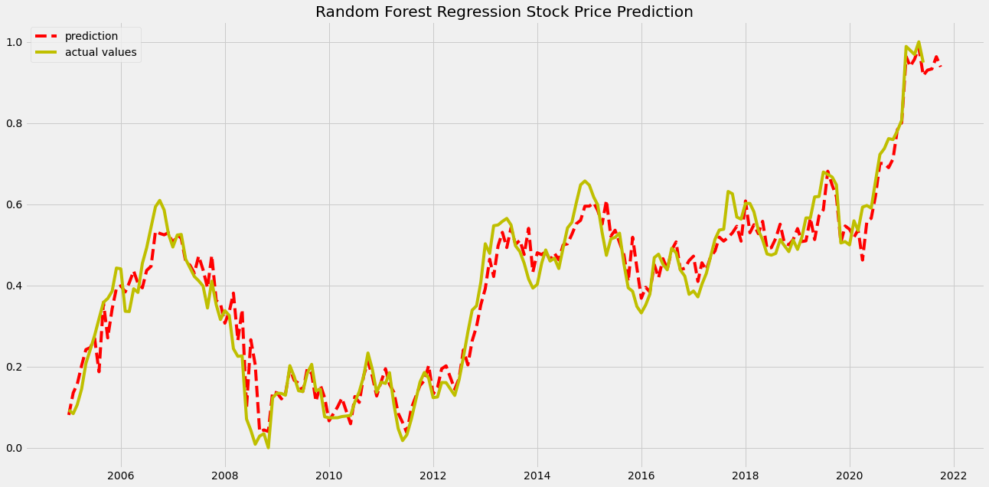
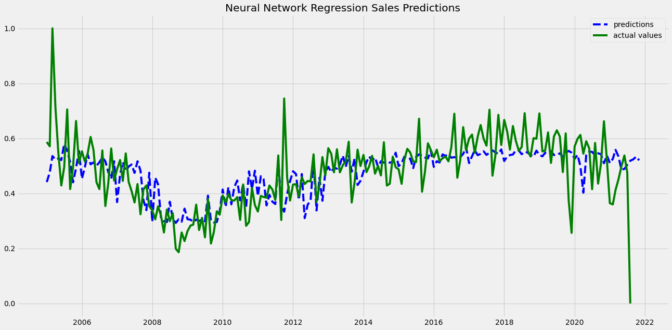
STOCK PRICE & SALES PREDICTION - TOYOTA

Slide 21
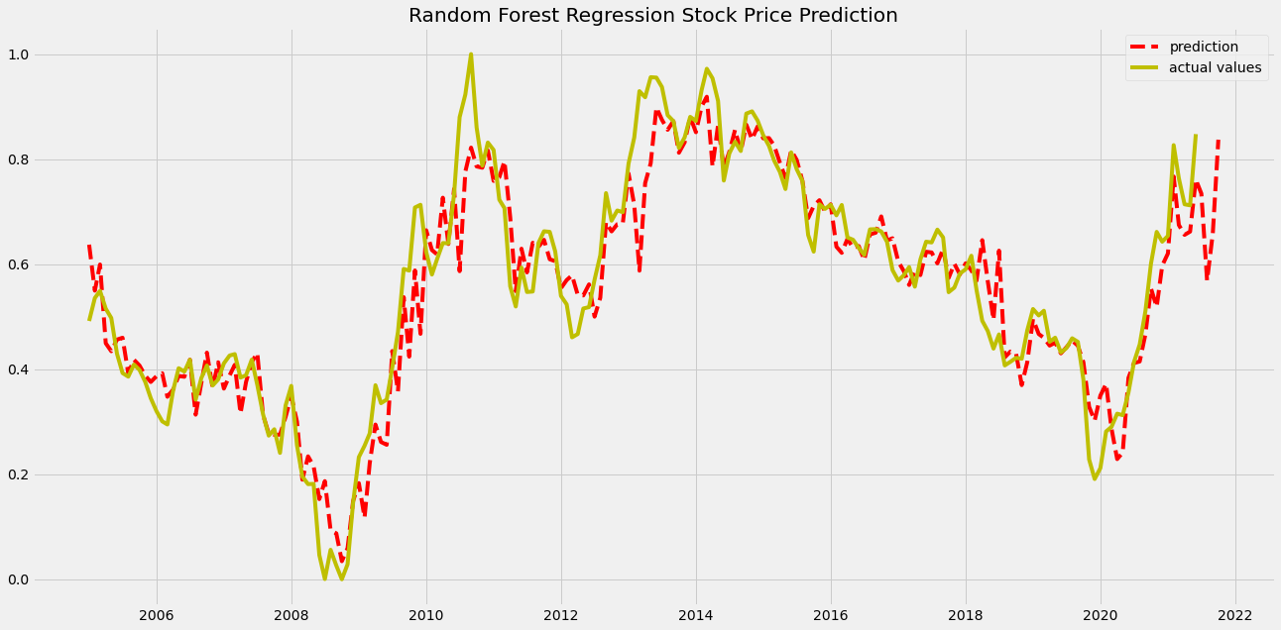
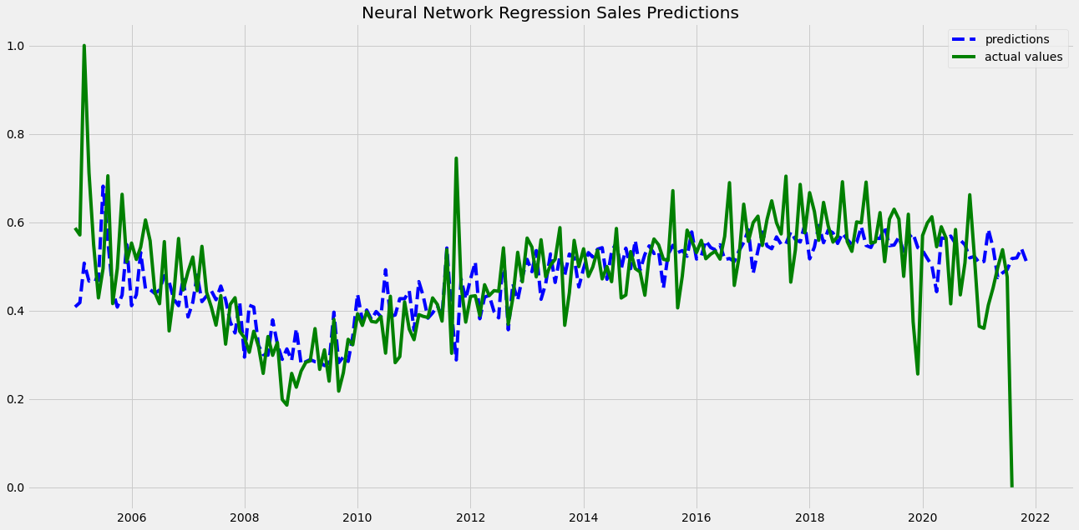
STOCK PRICE & SALES PREDICTION - FORD

Slide 22
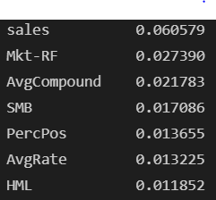
Feature Importance
Toyota Random Forest - Feature Importance

Slide 23
CONCLUSION & FUTURE DIRECTION
Anticipated Results:
High correlation between sentiments & sales units, and sentiments & stock price
Website reviews are more reliable data source than Twitter
High accuracy in our sales model.
Actual Results:
Causative relation between sentiments - stock prices and sentiments - sales unit.
Website reviews were more reliable than Twitter data
Decent increase in sales and stock prices of Toyota and Ford if positive reviews increases
Employees confidence in company affects company’s financial portfolio
Companies can improve their product features and CX using people’s sentiments.
Investors can determine when market is driven by people emotions and invest smartly in stocks.

Slide 24
Thank You!

